Slide 1


2016-2018 Sales Performance: Trends and Analysis
Bike’s Store
Presented by Robes Fokoueng January 2024
1

Slide 2
Sales performance overview over the 2016 to 2018 period
Over the 2016 to 2018 period, the company sold 7078 products for a turnover of $8, 578, 989.
However, from 2016 to 2017, turnover increased by 41.9%, followed by a 47.3% decrease in 2018.
Presented by Robes Fokoueng - January 2024
2

Slide 3
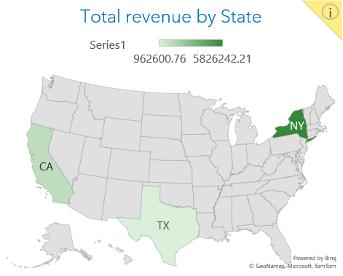
Sales Breakdown by State and Store
Despite its large population and vast territory, the state of Texas contributed 11% ($ 962,600.75) of the turnover. This is mainly due to the hot and humid climate and the great distances within and between cities in Texas.
With a larger population than Texas, the state of California contributed 21% ($1,790,145.90) of the turnover.
68% of the turnover was generated in the Baldwin bikes store(located in New York), 21% in the Santa Cruz bikes store(located in California) and 11% in the Rowlett bikes store(located in Texas).
Due to its high population density and parking problems, New York is the state with the highest turnover. It contributed 68% ($5, 826, 242) of the turnover.
Presented by Robes Fokoueng - January 2024
3

Slide 4
Sales Breakdown by Category , Brand and top 5 revenue by city and customer
The best-selling brand is Mountain Bikes (59.79% of turnover).
The best-selling brand is Mountain Bikes (35% of turnover).
Presented by Robes Fokoueng - January 2024
4

Slide 5
Key Driver of Sales Growth between 2016 and 2017
From 2016 to 2017, turnover increased by 41.9%.
This increase is due to the introduction in 2017 of a new product (Road Bikes) on the market that has performed quite well.
In 2017, the new product(Road Bikes) alone contributed 30.2% of the turnover, i.e. an amount of $1,161,450.67 for 333 units sold.
Presented by Robes Fokoueng - January 2024
5

Slide 6
Key Driver of Sales decrease between 2017 and 2018
At the beginning of the second quarter of 2018, more precisely in April, sales increased very strongly. However, there were no sales the following months and the company made very modest sales throughout the rest of 2018.
Presented by Robes Fokoueng - January 2024
6

Slide 7
What is the next steps?
Customer satisfaction: Collect customer reviews and feedback to understand their perception of this new product (Road Bikes) and identify areas for improvement.
Marketing: Analyze the effectiveness of each marketing channel (social media, advertising, etc.) to optimize budget allocation.
A/B testing: Test different versions of the marketing channel to determine which one perform best.
We must contact management to find out what really happened from April to December 2018.
Presented by Robes Fokoueng - January 2024
7

